Slide 1

Natural Language Processing in Python
Presented by : Sripansuang Tangsuwanjinda (陳帆昇)
ID : M07158029

Slide 2
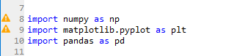
import numpy as np
import matplotlib.pyplot as plt
import pandas as pd
This is three basic library that use for Python programming. - numpy for basic mathematic function
- matplotlib for plotting
- pandas for calling CSV in python

Slide 3
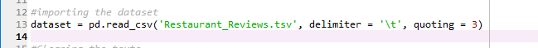
Open TSV file by CSV function
We call “Restaurant_Review.tsv” by pd.read_csv and contain it in variable name “dataset”
We teach program to separate the value by tab(\t)
For tell machine to ignore data also “” or ‘’

Slide 4
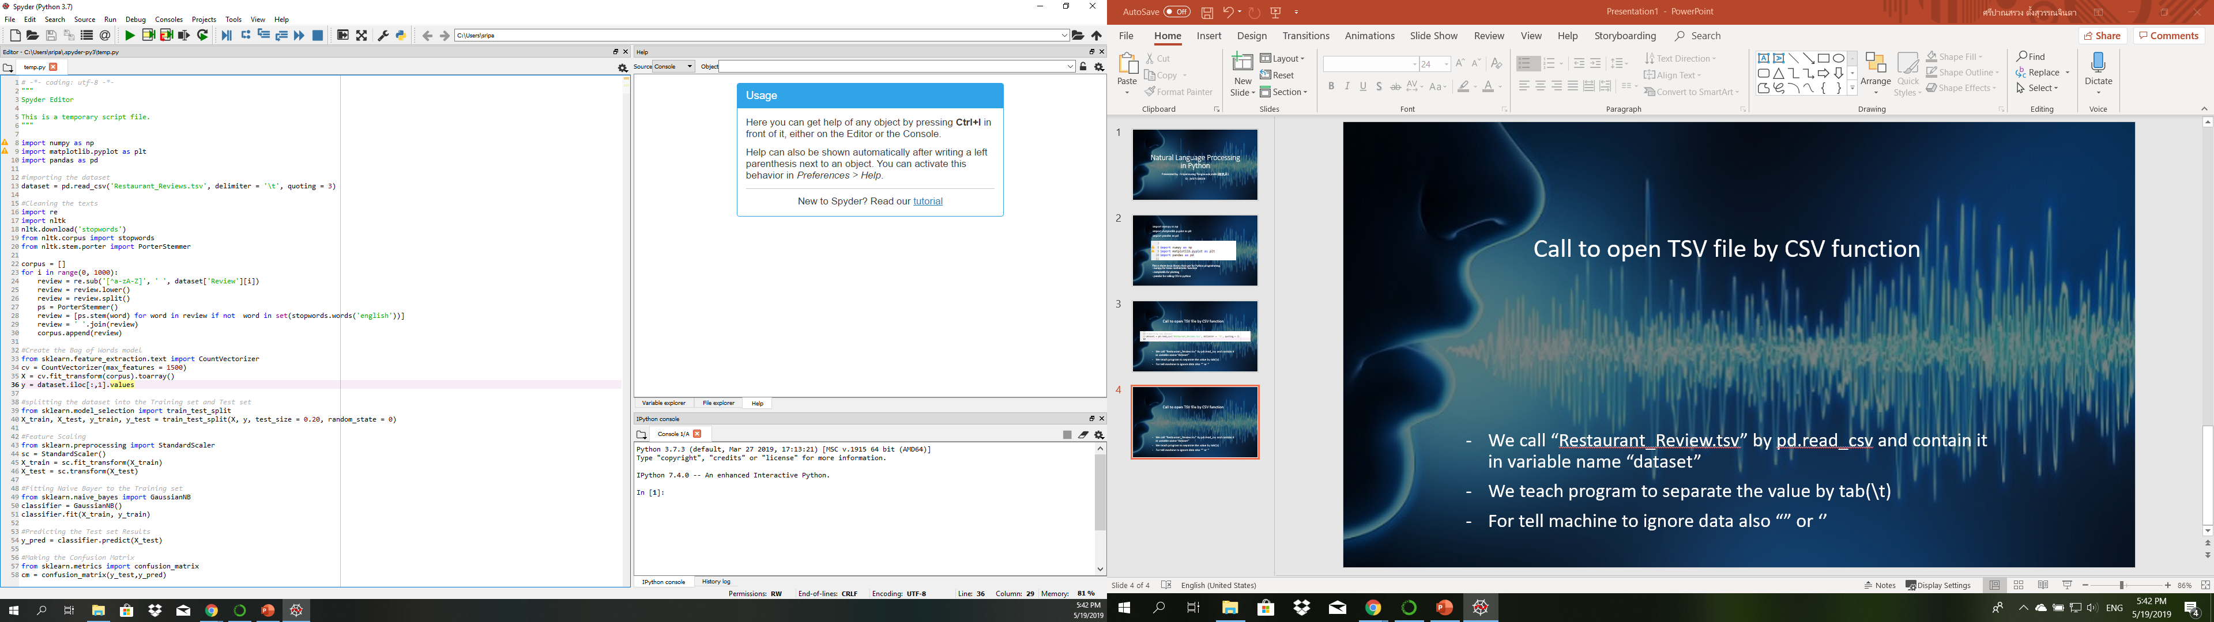
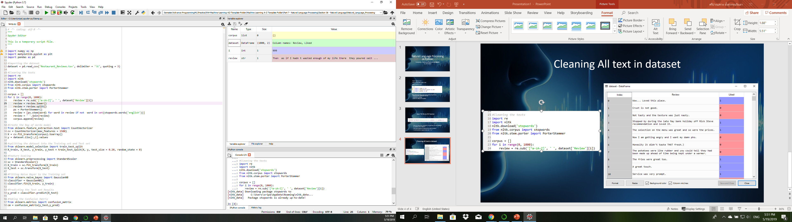
Cleaning All text in dataset

Slide 5
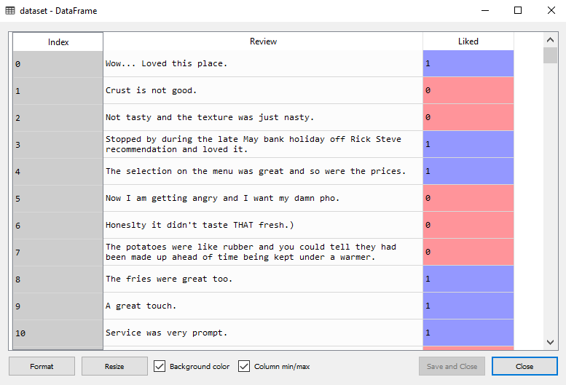
Cleaning All text in dataset

Slide 6
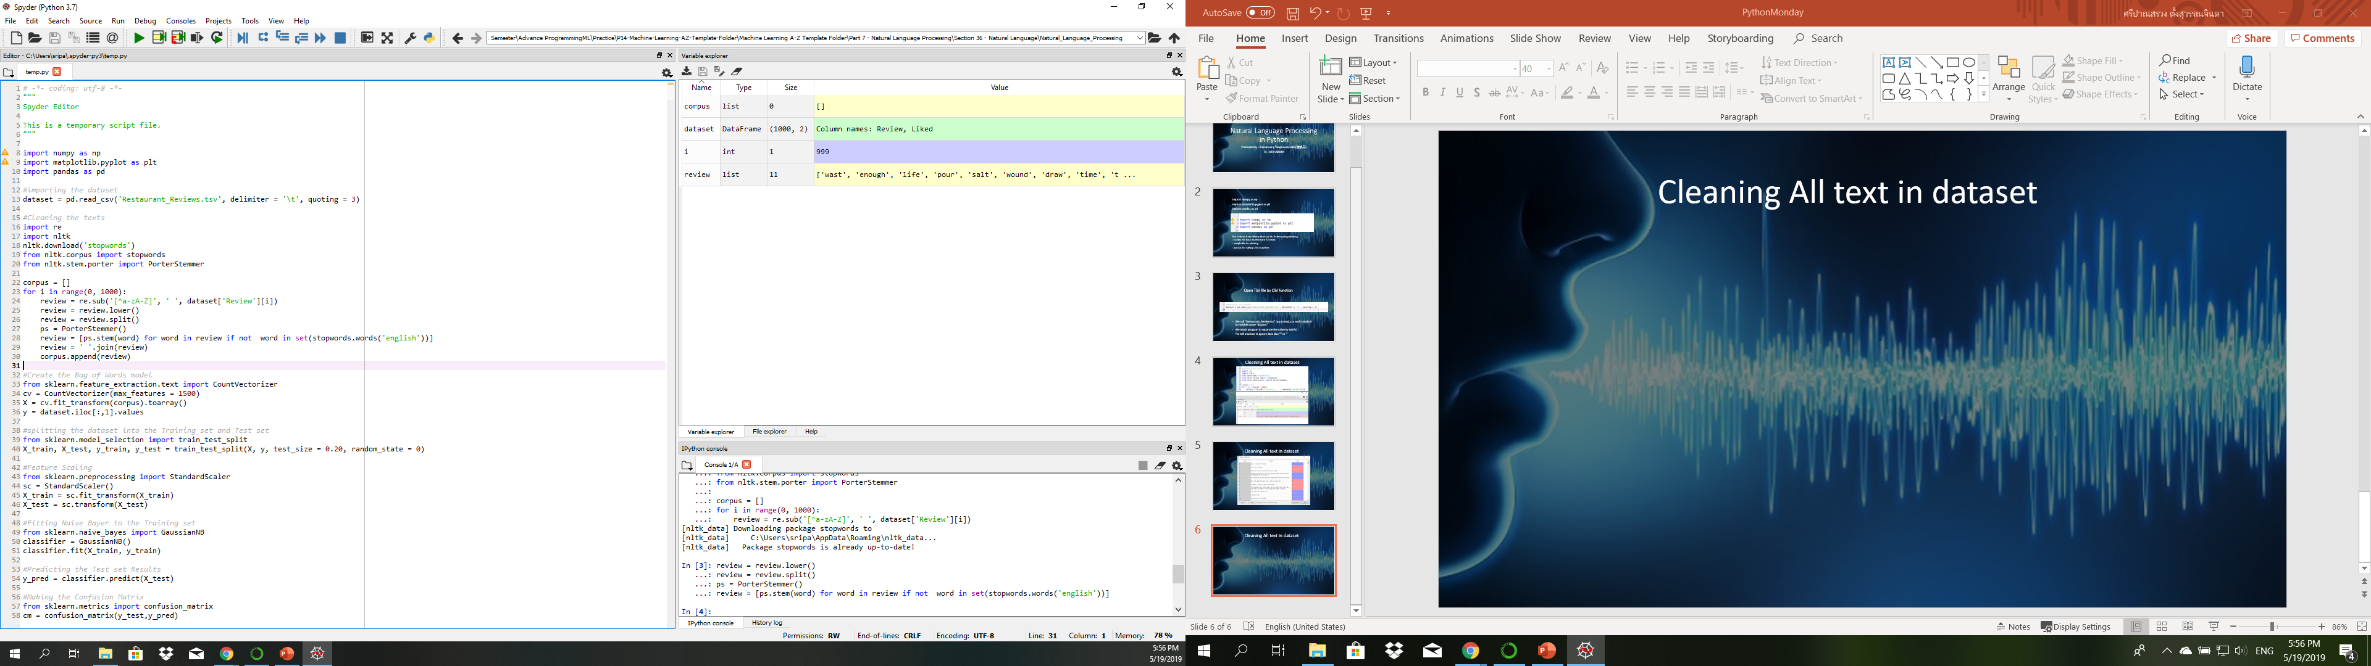
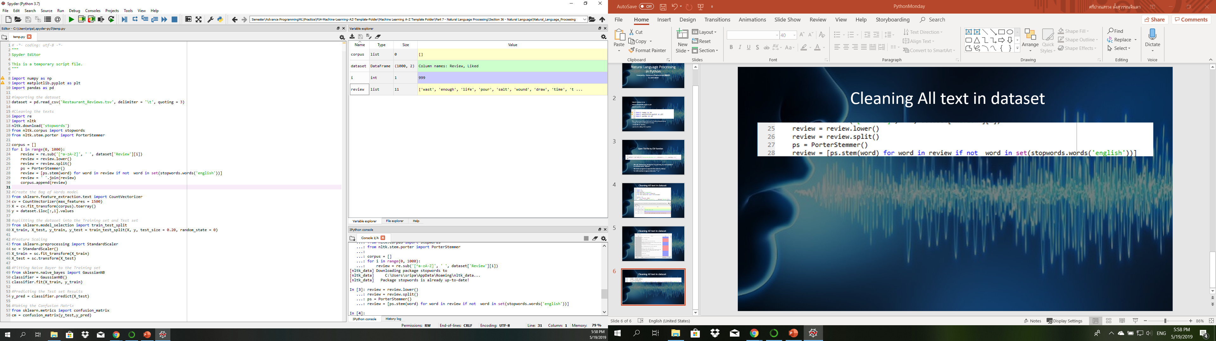
Cleaning All text in dataset

Slide 7
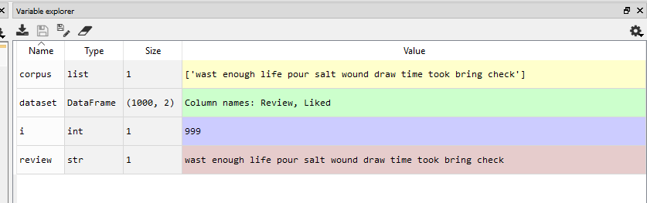
Cleaning All text in dataset

Slide 8
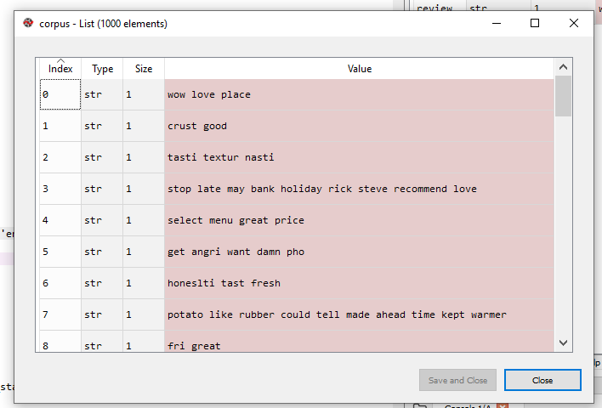
Cleaning All text in dataset

Slide 9
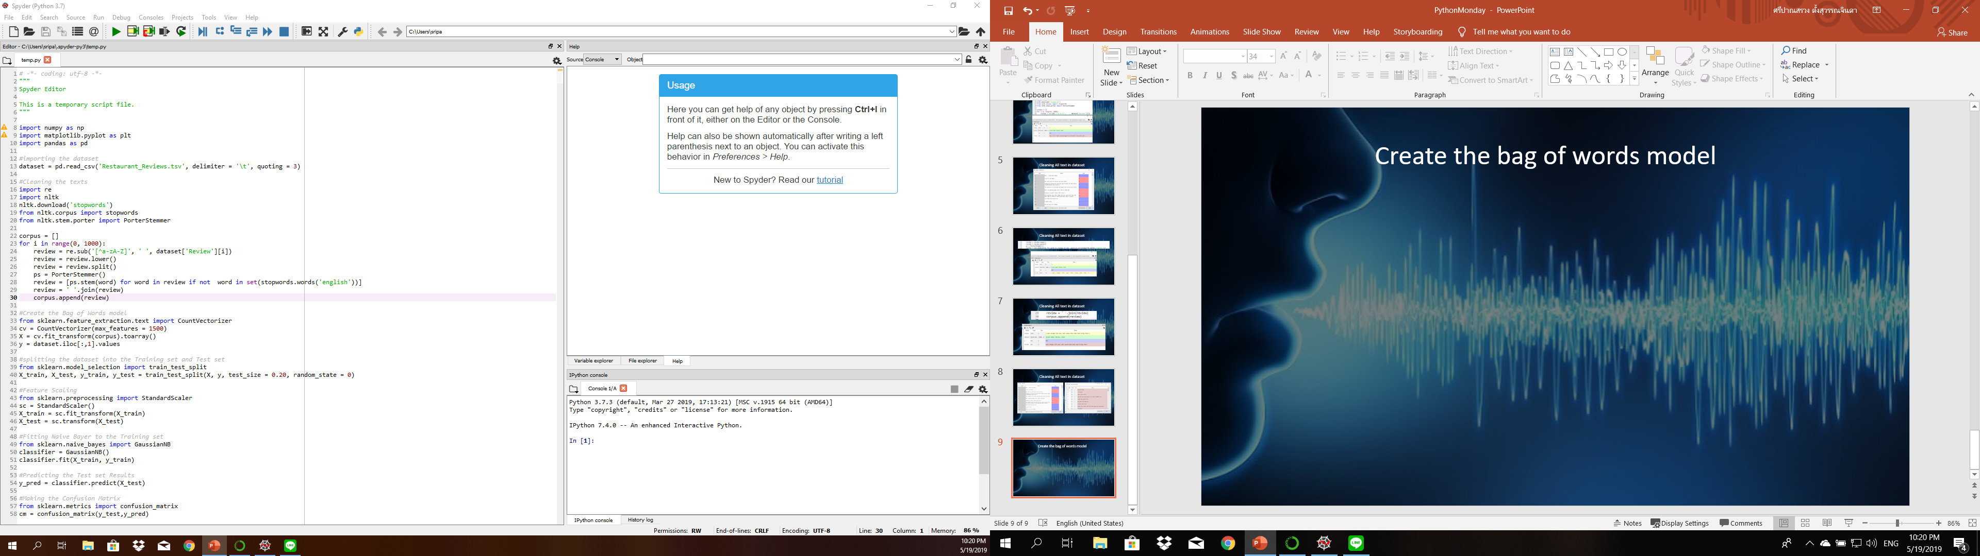
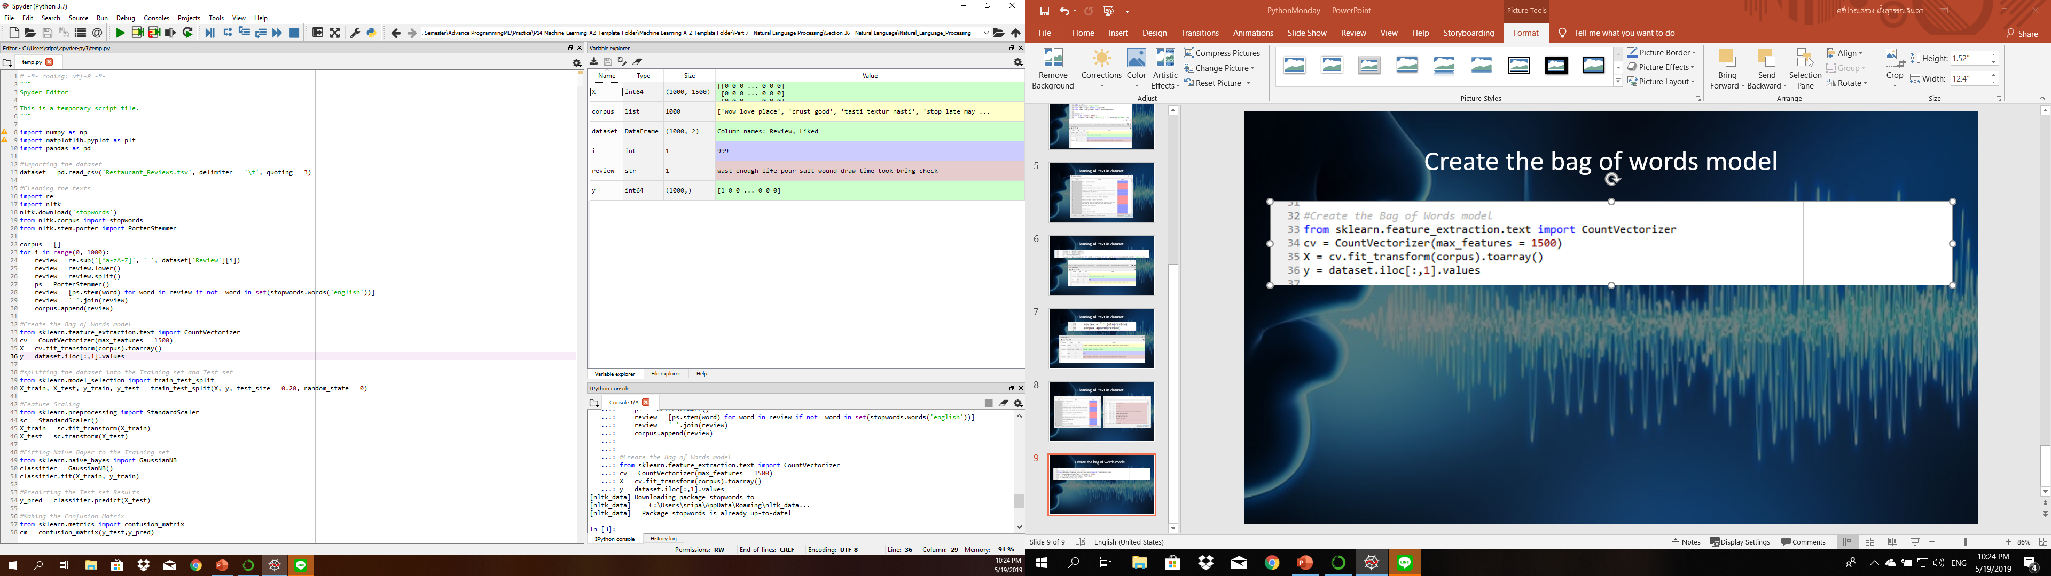
Create the bag of words model

Slide 10
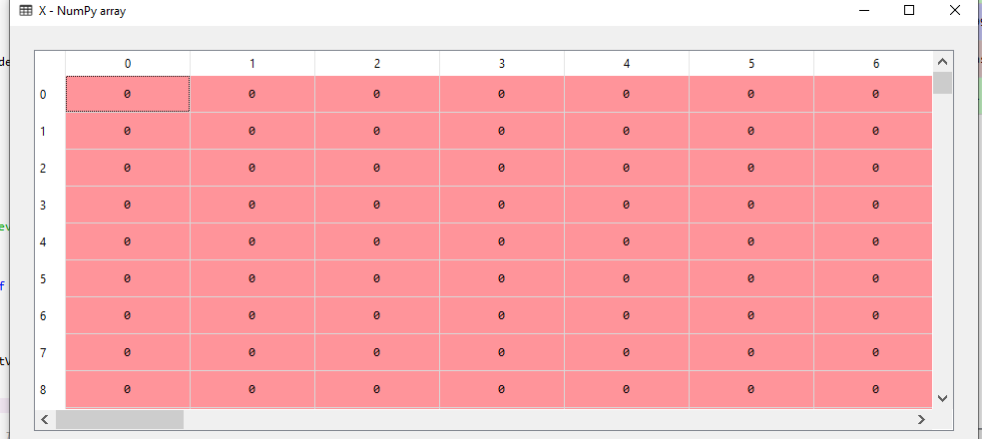
Create the bag of words model

Slide 11
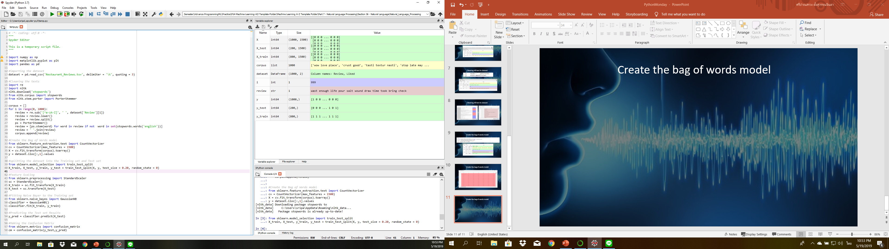
splitting the dataset into the Training set and Test set

Slide 12
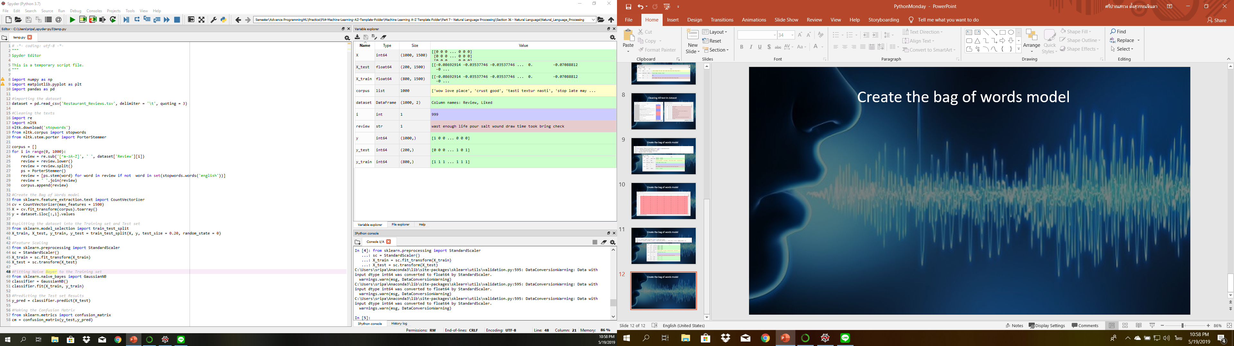
Feature Scaling

Slide 13
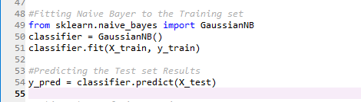
Fitting Naive Bayer to the Training set

Slide 14
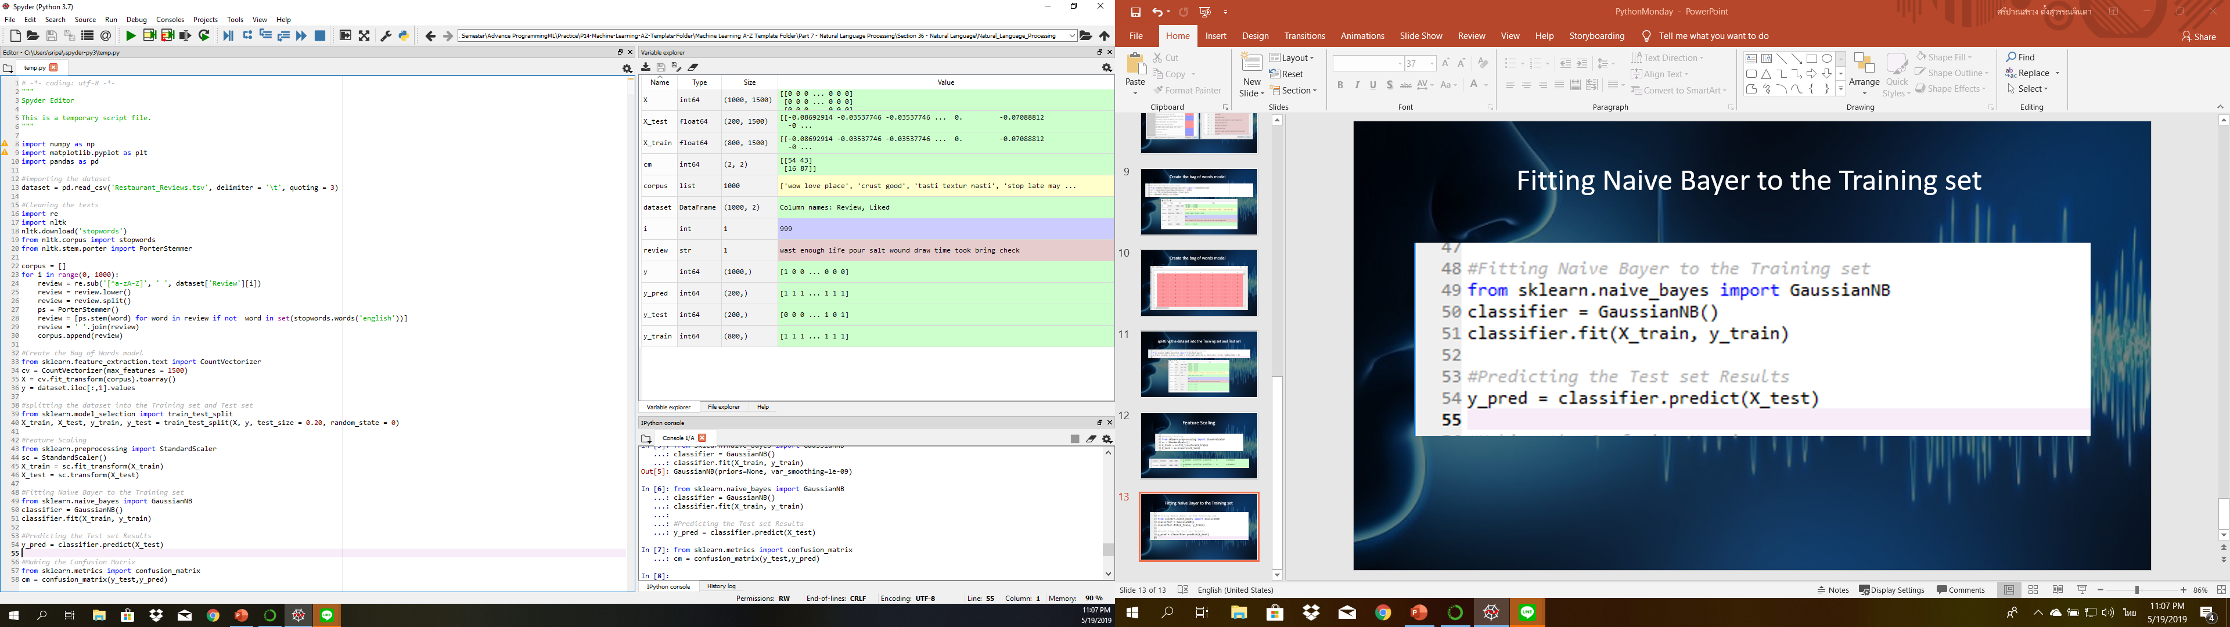
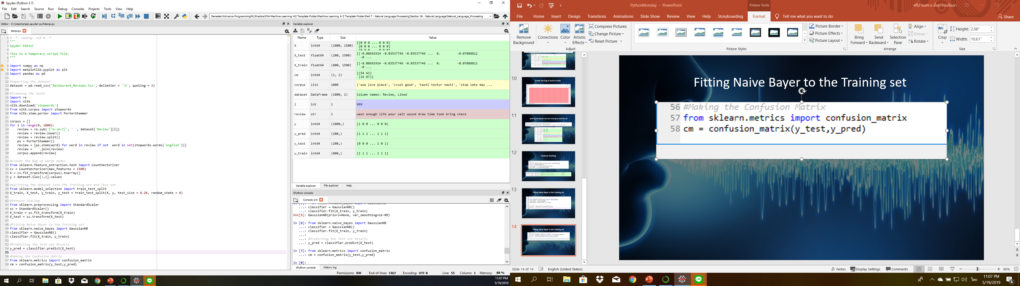
Making the Confusion Matrix

Slide 15
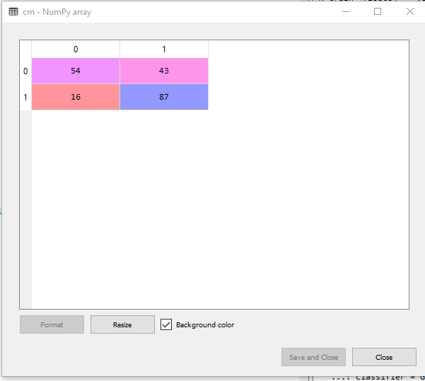
Making the Confusion Matrix

